Slide 1
MEDCLIENT
Computer Science : 3A
Due date; 21 May 2025

Slide 2
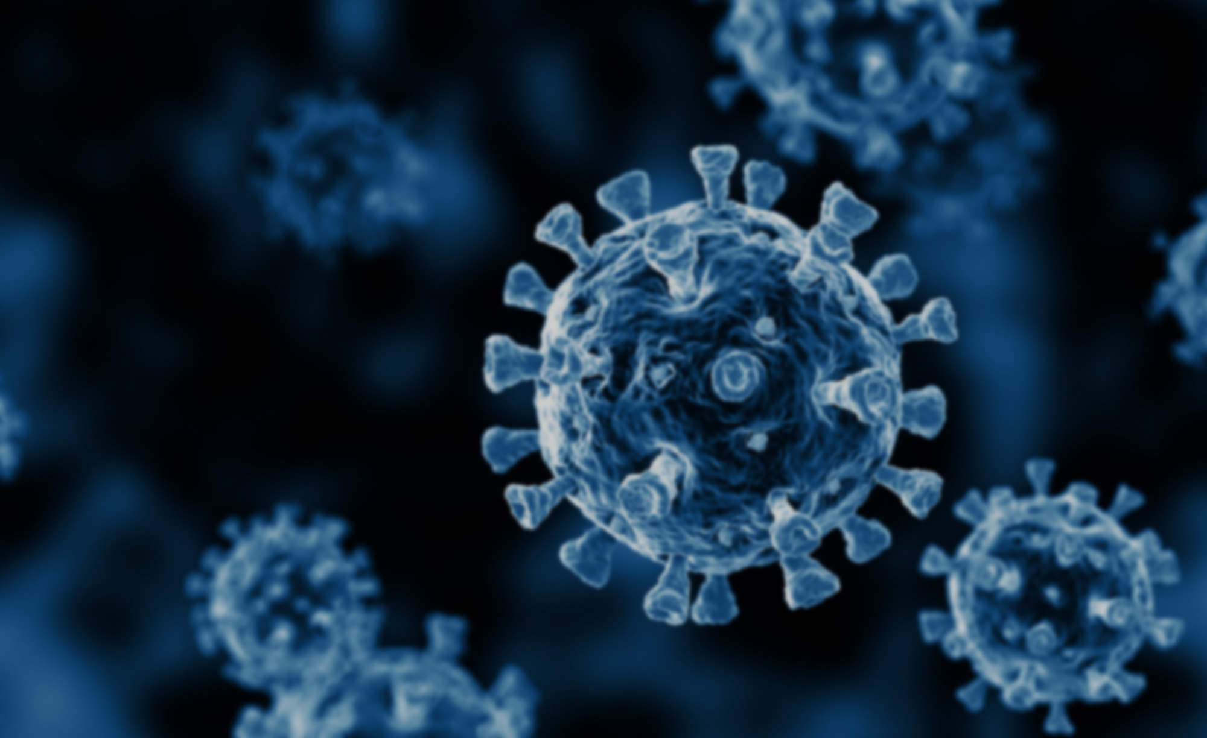
MEDCLIENT APP
GROUP MEMBERS:
J MOLOMO
A NKANYANA
D MASINE
DN MBOYI

Slide 3
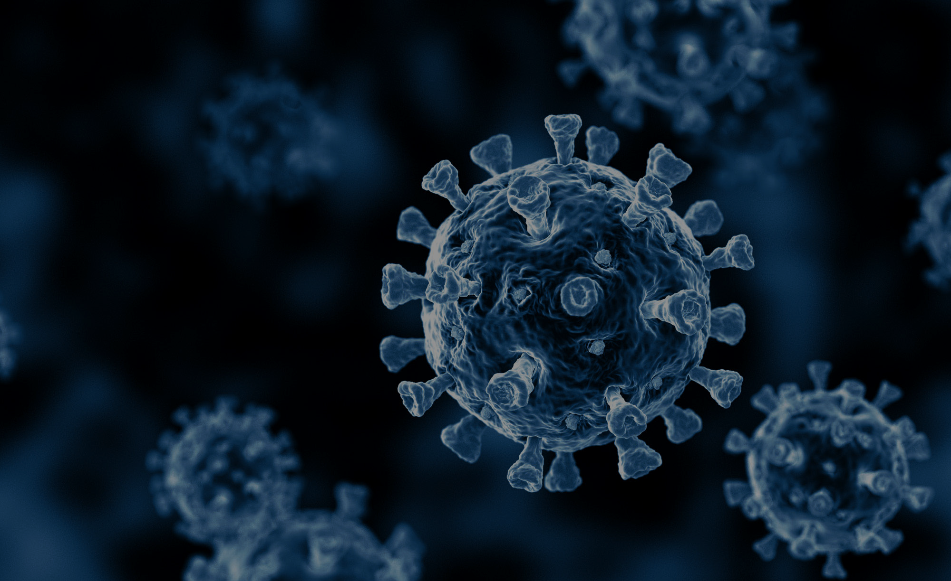
PROBLEM DESCRIPTION
Detecting COVID-19 infection by analyzing and comparing current X-ray scans with previous X-ray scans using emergent graph structures for image similarity and path finding.

Slide 4

HOW WE AIM TO SOLVE THE PROBLEM
We have created a medical client app that helps with disease detection and treatments suggestion.
Compare the scan with the built in one and return the similarity percentage , then suggest treatments according to the percentage.

Slide 5

TYPES OF GRAPH ALGORITHMS USED TO SOLVE THE PROBLEM
A * ALGORITHM
K-NN
SOBEL OPERATOR

Slide 6

HOW THE PROJECT WAS IMPLEMENTED
Step 1
Carried out the image processing using KNN to convert the image to a graph based structure and converted the image into a grayscale.
Step 3 Store the treatments information in an array list based heap, with the keys as arbitrary percentage similarities, and the values as the treatment details.
Step 4 Traversed the heap using the A* algorithm, searching for the percentage similarity calculated in step 2 and retrieving the value of that key as the recommended treatment. Additionally , if the key does not exist, then recommend the treatment within the range of 5, from the calculated percentage.
Step 2 Implemented the similarity detection algorithm, by extracting the pixels of the patients Xray scan and those of the built in Xray scan of a 100% infected person, then calculate the percentage similarity.

Slide 7

HOW THE MEDCLIENT APP WORKS
1.START
2.UPLOAD DETAILS
3. UPLOAD SCAN
4.DIAGNOSE
5.TREATMENT

